Slide 1
Devotion to clean the ocean
Maddie essig
1

Slide 2

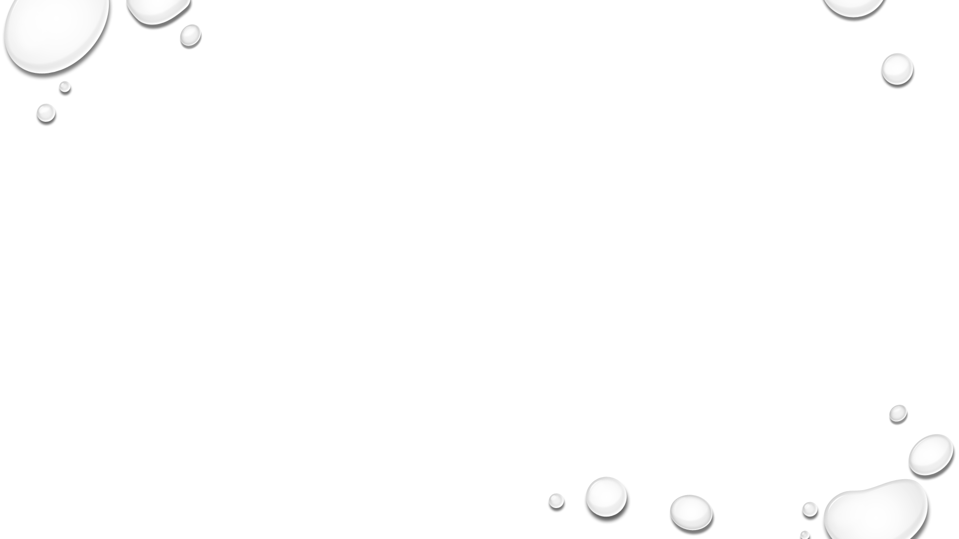
What really is plastic pollution?
Plastic Pollution is the accumulation and permeation of man-made plastics into the environment reaching a point when they wreak havoc on ecosystems and the wildlife that inhabit them. (seasave.org)

Slide 3
Why plastic waste is an issue you should learn about
Roughly 8 tons of plastic enter the ocean every year, to put that in perspective its equal to a garbage truck dumping plastic into the ocean every single minute
According to a report presented at the 2017 United Nations Marine Conference, as many as 51 trillion microplastic particles, 500 times more than the stars in our galaxy, litter our oceans and seas, seriously threatening marine wildlife.
(seasave.org)

Slide 4
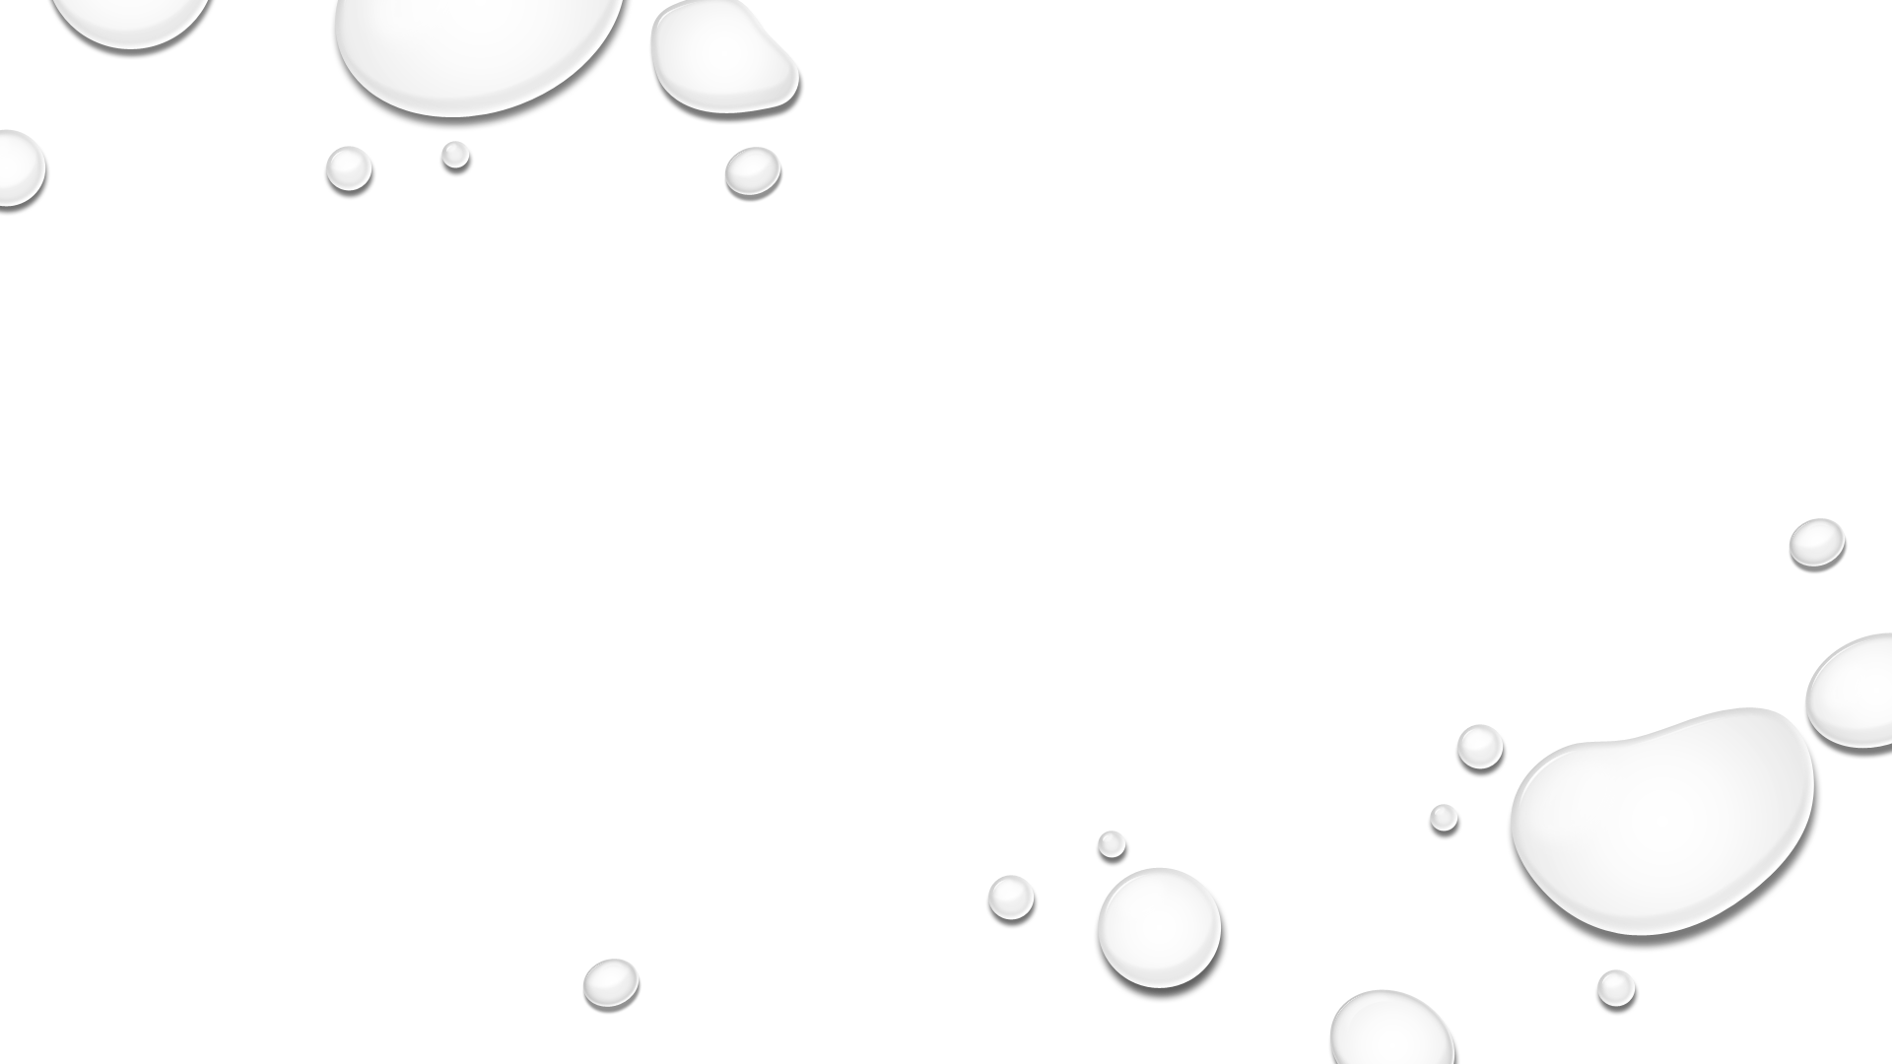
Plastic bags and their affect on the Earth and animals

Slide 5
Marine life
sea animals are regularly found to be tangled up in plastic bags, with some even being choked to death by them (fairplanet.org)
The sea animals, specifically turtles, mistake the bags for their food and the bags destroy the animals’ digestive systems.
at least forty percent of marine mammals and seabird species are affected by ingestion of inorganic plastics (seasave.org)
at least 267 different species are known to have suffered from entanglement and ingestion of plastic debris. (plastic-pollution.org)
The National Oceanographic and Atmospheric Administration said that plastic debris kills an estimated 100,000 marine mammals annually, millions of birds and fishes. (plastic-pollution.org)

Slide 6
What you can do to help the planet
Instead of using plastic grocery bags the store gives you when shopping, bring your own reusable bags
Use a reusable water bottle/cup instead of a plastic one
Never ever litter
Always recycle your plastics

Slide 7
Sign my petition
This petition is to implement a fee on plastic grocery bags in Baltimore CountY stores in order to motivate people to use reusable bags instead.
Please sign as another way to do your part in helping the environment
http://chng.it/HZVM2XZvf5

